Slide 1
Chapter 10
EXCEPTION HANDLING
Copyright © 2013 by The McGraw-Hill Companies, Inc. All rights reserved.

Slide 2
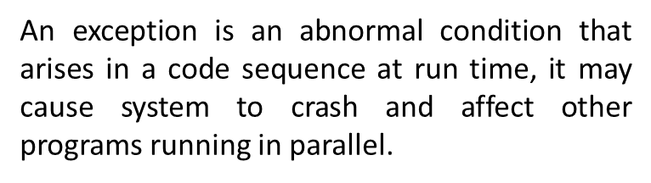
Exception
How is an Exception represented in Java?

Slide 3
A Java exception is an object that describes an exceptional (that is, error) condition that has occurred in a piece of code
When an exceptional condition arises, an object representing that exception is created and thrown in the method that caused the error
That method may choose to
a) handle it self
or
b) pass it on.
At some point the exception is caught and processed

Slide 4
The Exception Hierarchy
In Java, all exceptions are represented by classes. All exception classes are derived from a class called Throwable. Thus, when an exception occurs in a program, an object of some type of exception class is generated.
There are two direct subclasses of Throwable: Exception and Error.
Exceptions of type Error:
Errors that occur in the Java virtual machine itself, and not in the program.
Beyond the user control, and the program will not usually deal with them.
Errors that result from program activity are represented by subclasses of Exception.
For example, divide-by-zero, array boundary, and file errors fall into this category. The program should handle exceptions of these types. An important subclass of Exception is RuntimeException, which is used to represent various common types of run-time errors.

Slide 5
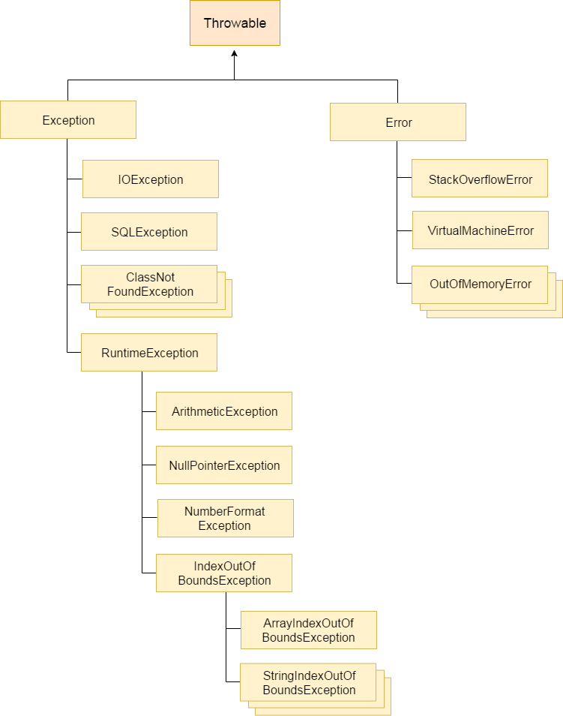

Slide 6
Exception Handling Fundamentals
Java exception handling is managed via five keywords:
try, catch, throw, throws, and finally

Slide 7
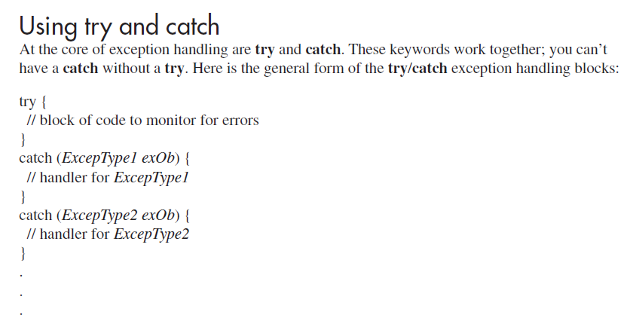

Slide 8
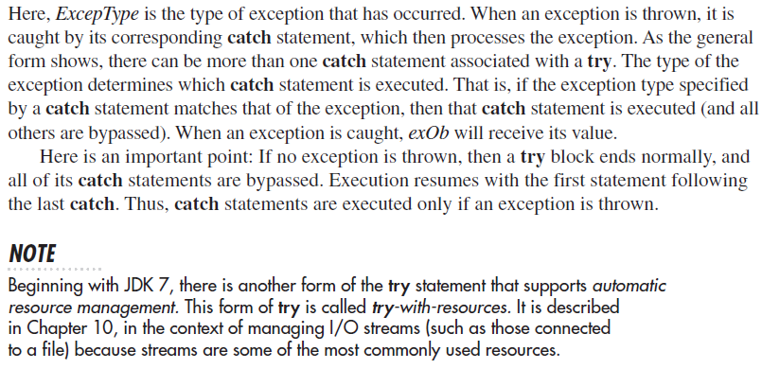

Slide 9
A Simple Exception Example
Using
try and catch blocks

Slide 10

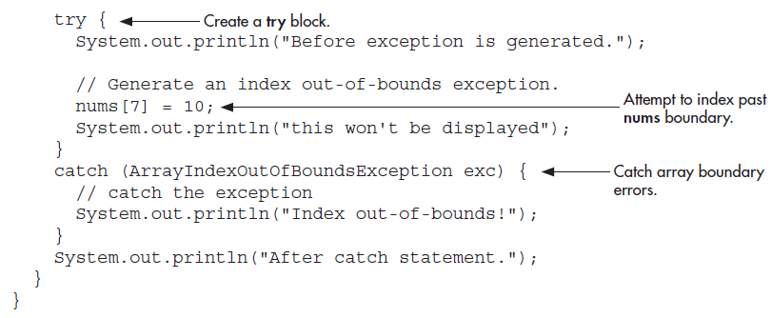

Slide 11
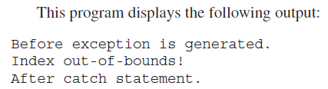
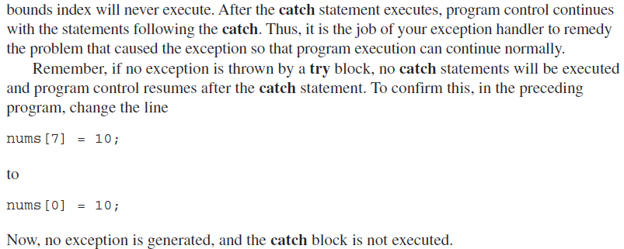

Slide 12

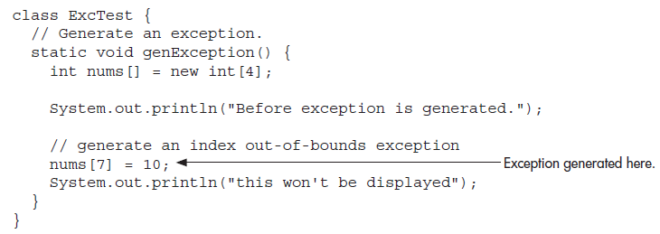

Slide 13
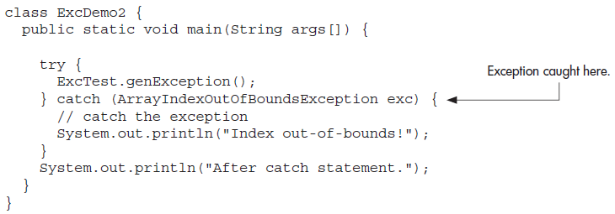


Slide 14
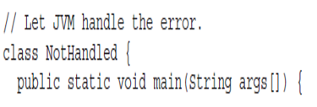
The Consequences of an Uncaught Exception
If your program does not catch an exception, then it will be caught by the JVM. The JVM’s default exception handler terminates execution and displays a stack trace and error message
Notes:
A Stack Trace is produced automatically by the Java Virtual Machine when an exception is thrown to indicate the location and progression of the program up to the point of the exception. The most recent method calls are at the top of the list.

Slide 15
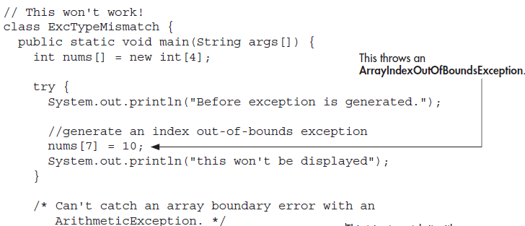

Slide 16
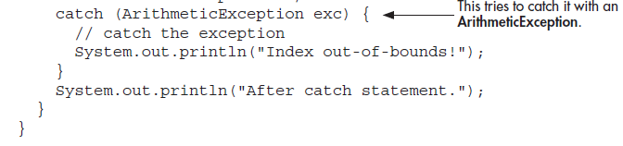
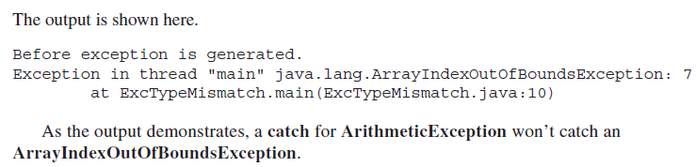

Slide 17
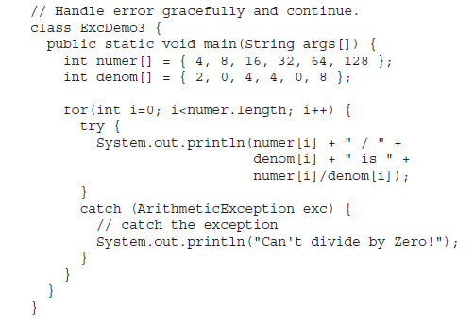
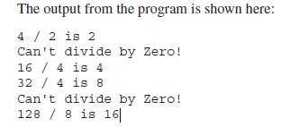
Exceptions Enable You to Handle Errors Gracefully
Notes:
Attractively handling

Slide 18
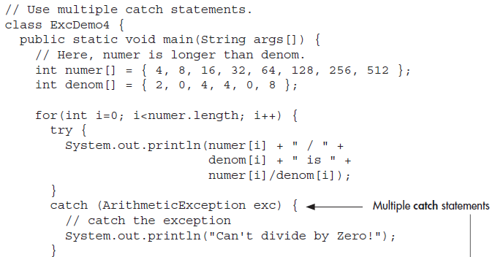
Using Multiple catch Statements

Slide 19
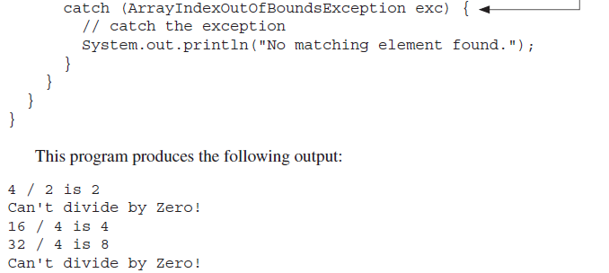


Slide 20
Catching Subclass Exceptions
If you want to catch exceptions of both a superclass type and a subclass type, put the subclass first in the catch sequence.
Putting the superclass first causes unreachable code to be created, since the subclass catch clause can never execute

Slide 21
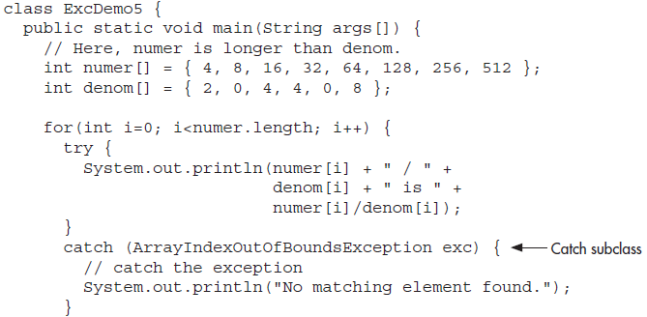

Slide 22
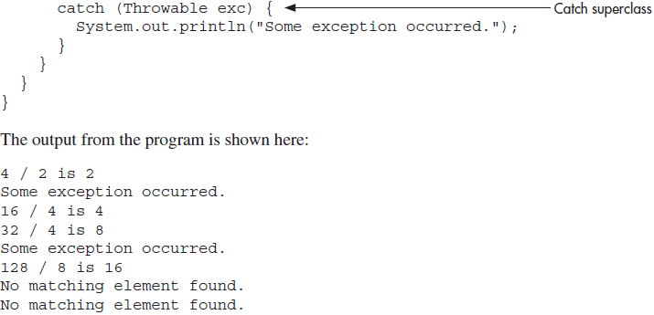

Slide 23
Nested Try
A try statement can be inside the block of another try
Each time a try statement is entered, the context of that exception is pushed on the stack.
If an inner try statement does not have a catch handler for a particular exception, the stack is unwound and the next try statement’s catch handlers are inspected for a match
This continues until one of the catch statements succeeds, or until all of the nested try statements are exhausted
If no catch statement matches, then the Java run-time system will handle the exception

Slide 24
Try Blocks Can Be Nested

Slide 25
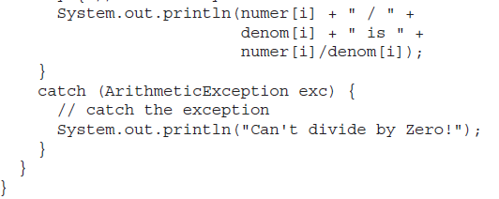
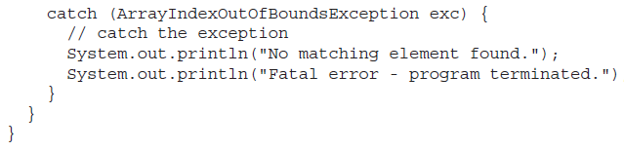

Slide 26
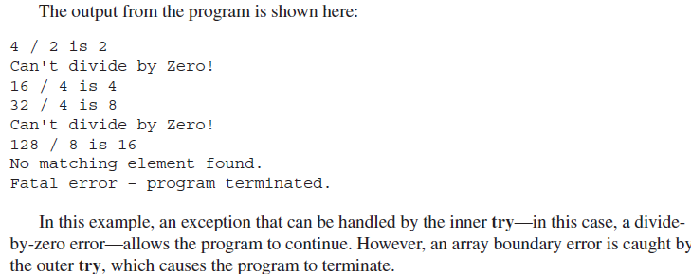

Slide 27
Throwing an Exception
It is possible to manually throw an exception by using the throw statement. Its general form is shown here:
throw exceptOb;
Here, exceptOb must be an object of an exception class derived from Throwable.
Here is an example that illustrates the throw statement by manually throwing an ArithmeticException:

Slide 28
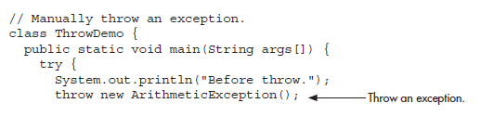
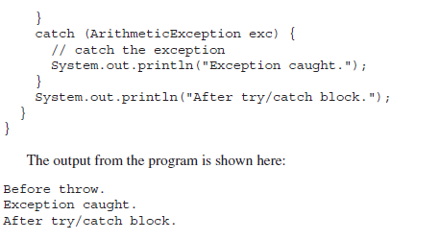
throw Demo

Slide 29
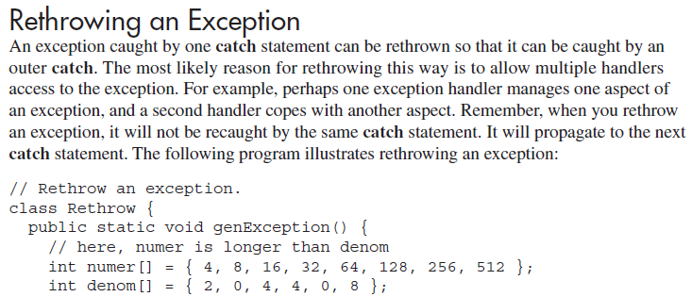

Slide 30
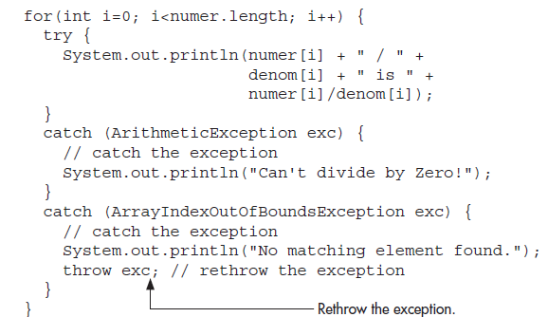

Slide 31
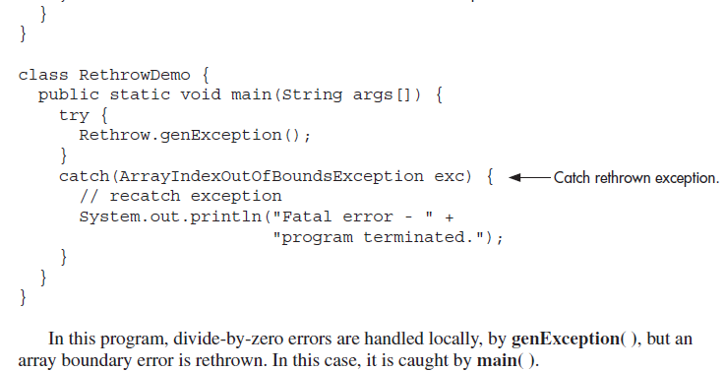

Slide 32
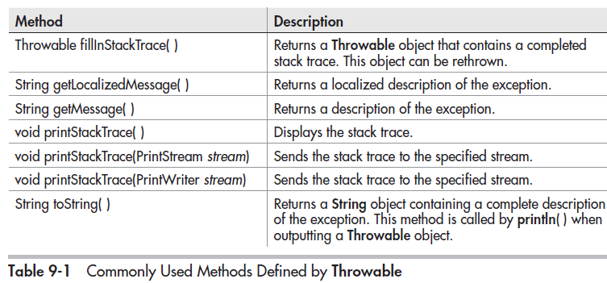

Slide 33
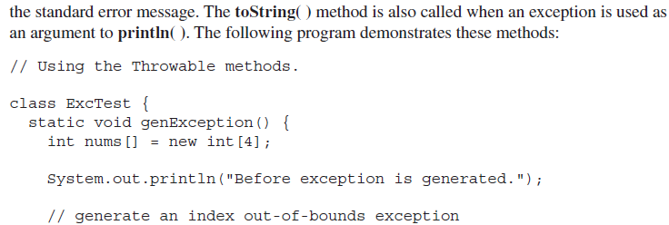

Slide 34
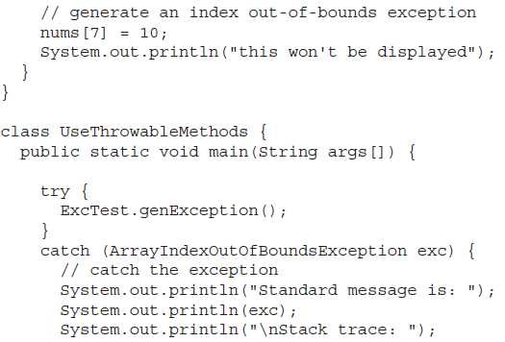

Slide 35
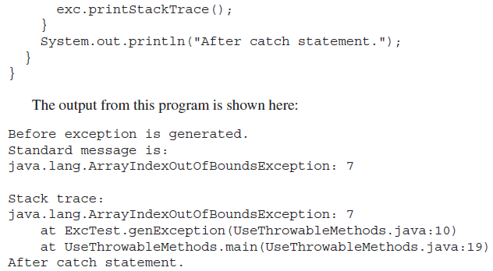

Slide 36
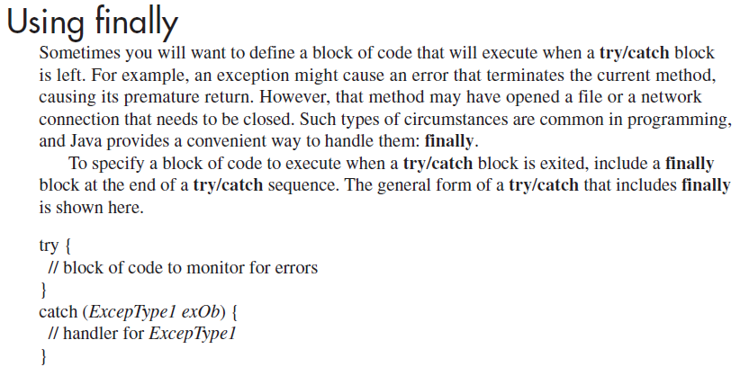
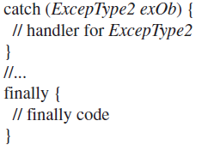

Slide 37
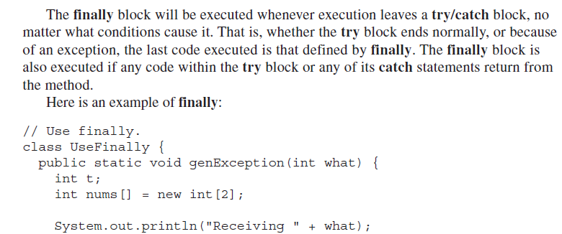

Slide 38
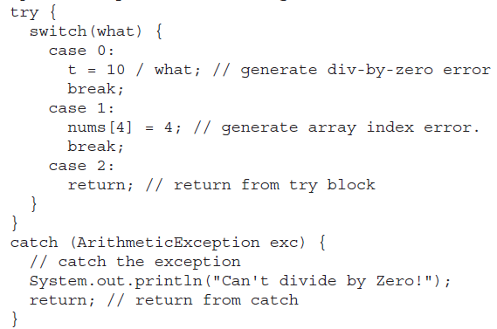

Slide 39
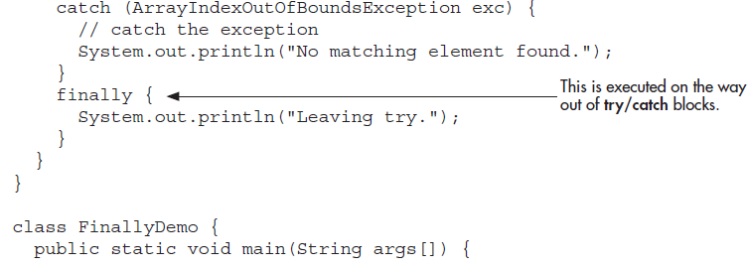
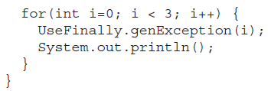

Slide 40
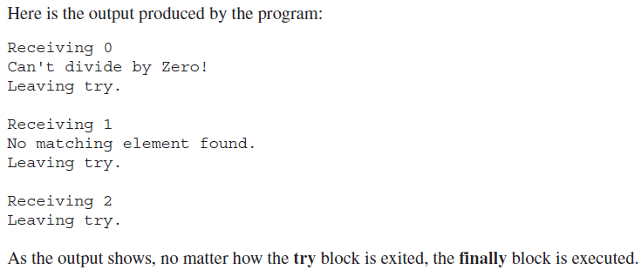

Slide 41
Using throws
In some cases, if a method generates an exception that it does not handle, it must declare that exception in a throws clause. Here is the general form of a method that includes a throws clause:
ret-type methName(param-list) throws except-list
{ // body }
Here, except-list is a comma-separated list of exceptions that the method might throw outside of itself.
Exceptions that are subclasses of Error or RuntimeException don’t need to be specified in a throws list. Java simply assumes that a method may throw one. All other types of exceptions do need to be declared. Failure to do so causes a compile-time error.

Slide 42
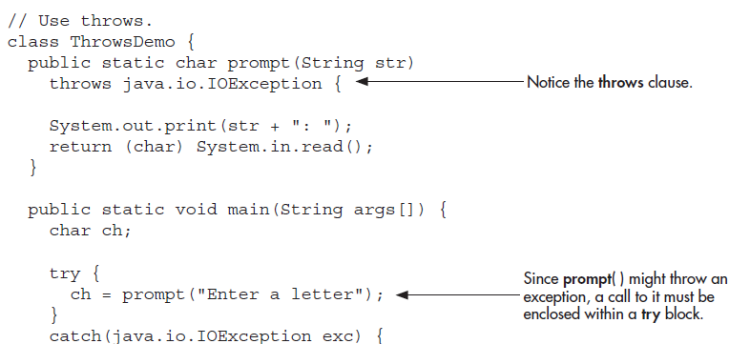

Slide 43
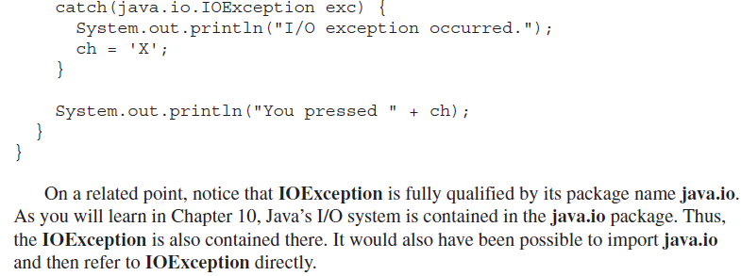

Slide 44
Three Recently Added Exception Features
The first supports automatic resource management, which automates the process of releasing a resource, such as a file, when it is no longer needed. It is based on an expanded form of try, called the try-with-resources statement.
The second is multi-catch allows two or more exceptions to be caught by the same catch clause.
The third is
final rethrow or more precise rethrow

Slide 45
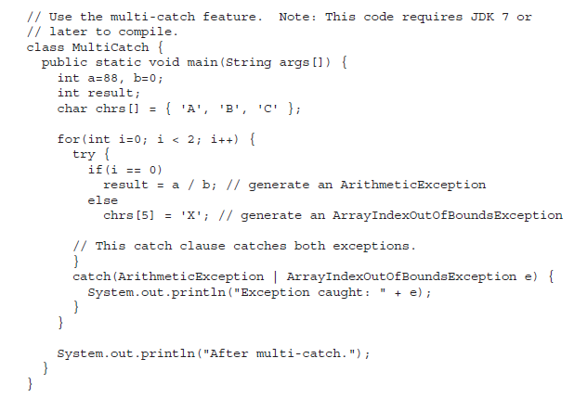
Multi catch

Slide 46
More precise rethrow
The more precise rethrow feature restricts the type of exceptions that can be rethrown to only those checked exceptions that the associated try block throws, that are not handled by a preceding catch clause, and that are a subtype or supertype of the parameter.

Slide 47
Java’s Built-in Exceptions
Unchecked exceptions:
The compiler does not check to see if a method handles or throws these exceptions.
They need not be included in any method’s throws list
Checked exceptions:
Must be included in a method’s throws list if that method can generate one of these exceptions and does not handle it itself.

Slide 48
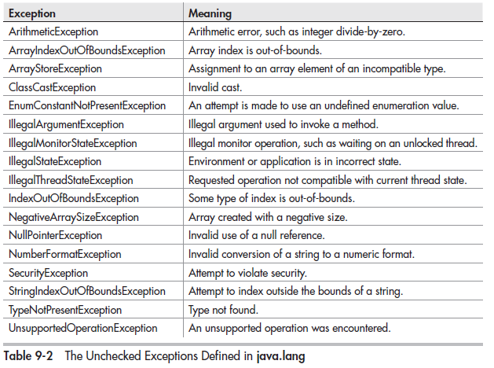

Slide 49
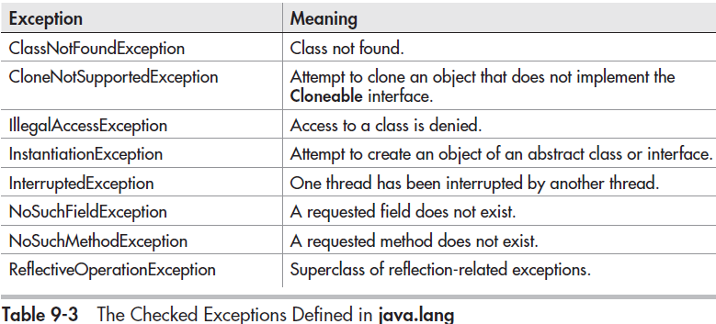

Slide 50
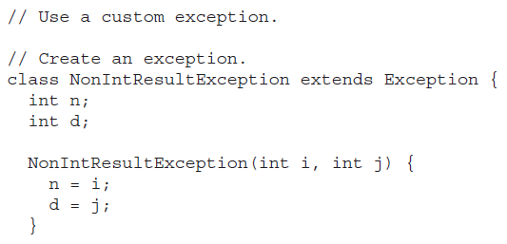
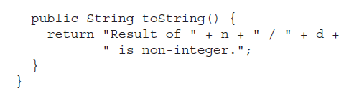
Creating Exception Subclasses

Slide 51
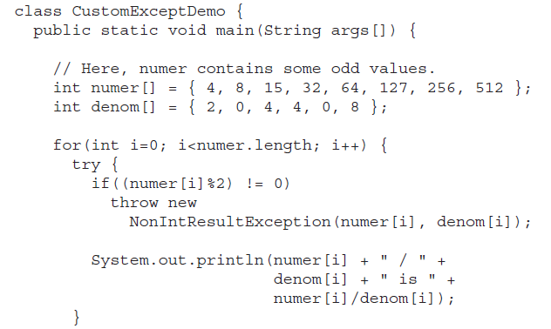

Slide 52
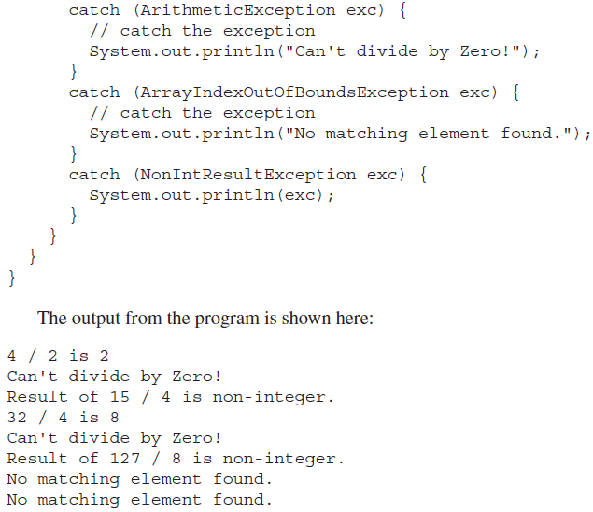

Slide 53
Questions
What class is at the top of the exception hierarchy?
What are checked and unchecked exceptions?
Differentiate between throw and throws keywords.
What is the significance of finally keyword? Explain.

Slide 54
throw throws
throw ExceptionObject throws comma separated list of checked Exception classes
void fn()
{…
….
throw e;
}
void fn() throws IOException, SQLException
{…
…
throw e;
}

